Slide 1
Led Array
Project Ontwerpen
Bo Mengels

Slide 2
Table of contents
Introduction
Results
Discussion

Slide 3
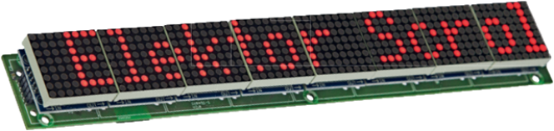
Introduction
Ledarray
8x8 led matrices
Esp-12
Large array

Slide 4



Results
Driver
Software
Hardware
Usage

Slide 5
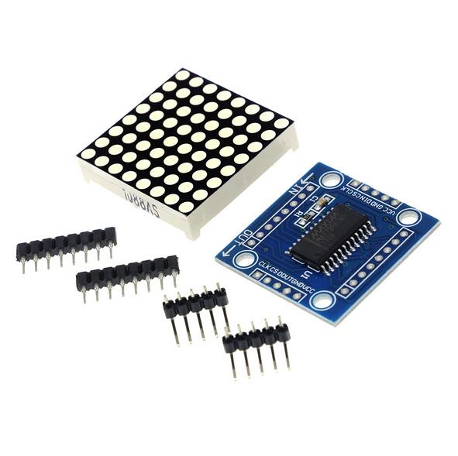
Driver
MAX7219
Communication
Microcontroller

Slide 6

Software
Library
Displayed text
Arduino-IDE

Slide 7
Hardware
SMD and through hole components
Pinheaders
5V
3D printing
Logo

Slide 8
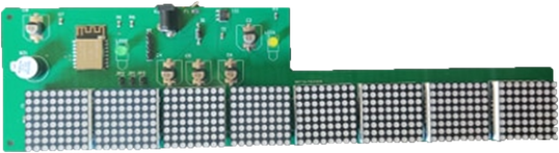
Usage
UART-USB cable
Wi-Fi
IP-address
Webpage
Text and brightness
Buzzer

Slide 9
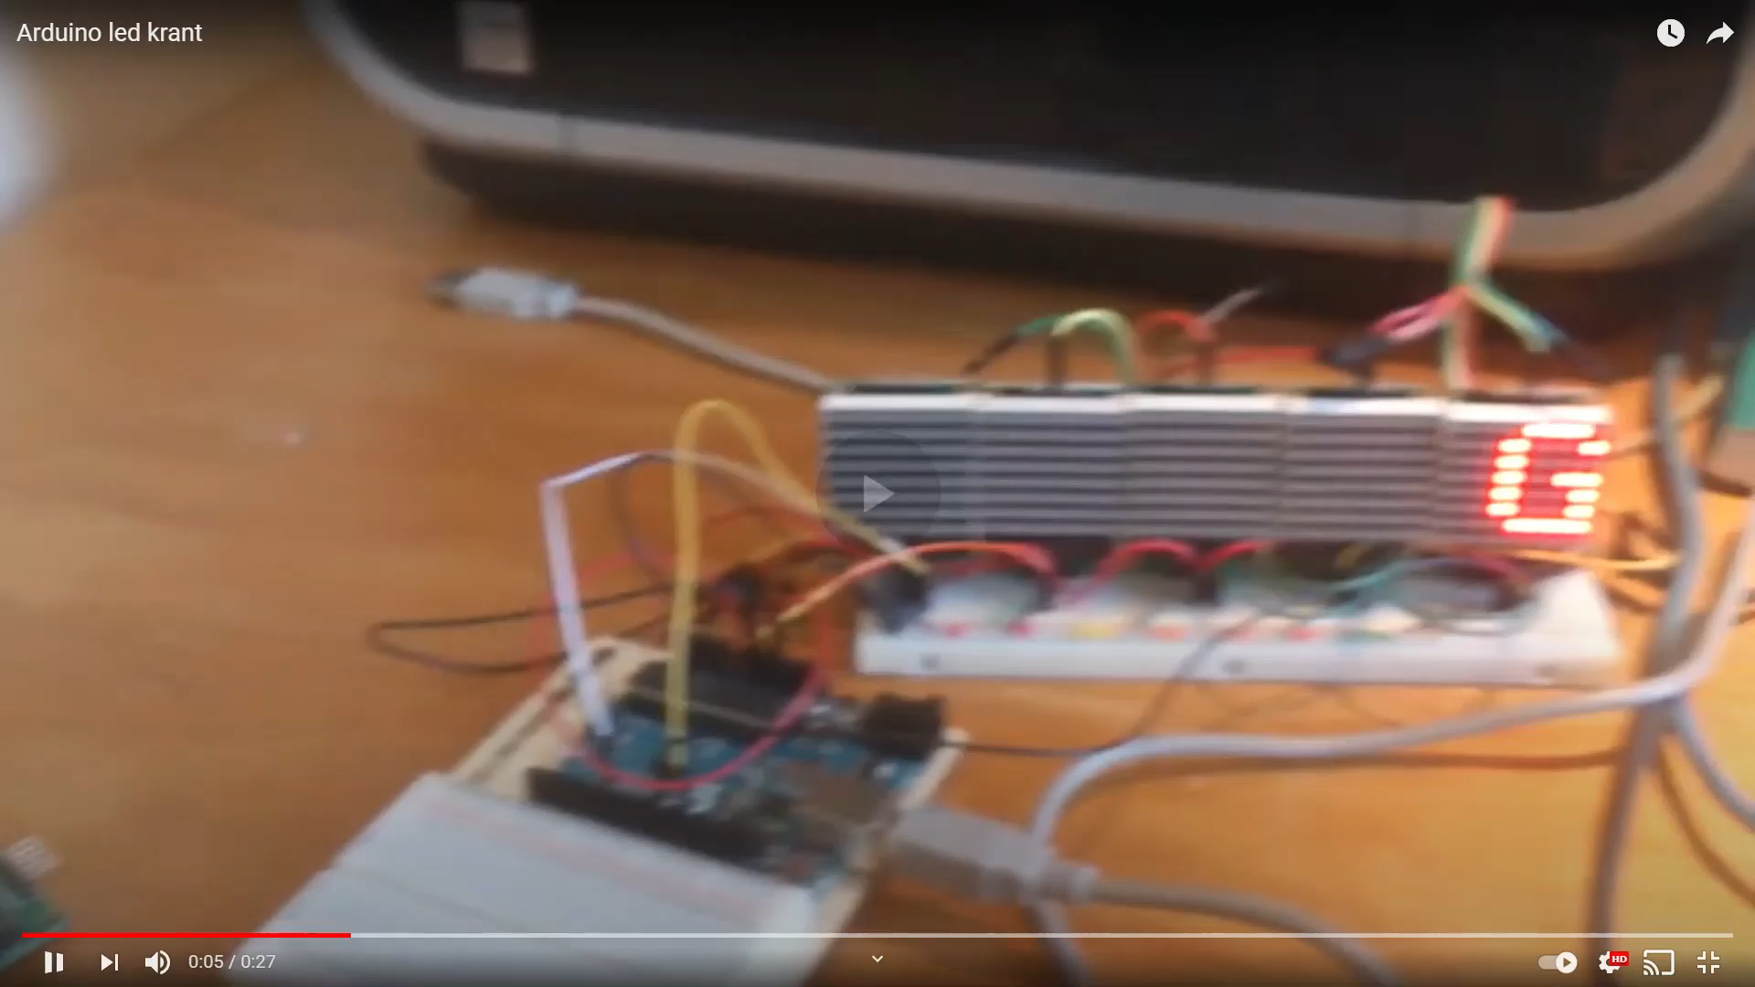
Demonstration

Slide 10
Discussion
Difficulties
Reflect

Slide 11
Difficulties
Covid-19
Footprints
Measurements
Programming

Slide 12
Reflect
Timing
Not finished

Slide 13
The end
Questions?

